Slide 1















Associations
Media Partners
Brought to you by
@ConstructionSum
@Constructionsummits
Construction Summits

Slide 2



Brought to you by
Mike Buss
  Head of Quality, Taylor Woodrow
  ConSIG Competency Working Group Chair
Construction Special Interest Group (ConSIG)
  Quality specialists across the industry
  Promote & improve quality
Inspection & Test Plans
  Common themes
  Different perspectives
How can we maximise positive value from ITP’s?
  Outcome achieved (i.e benefits)
  Methodology
Notes:
Good afternoon. For those of you I have not had the pleasure to meet my name is Mike Buss, and, although I am the Head of Quality for Taylor Woodrow, today I actually speak to you in my capacity as a member of the Chartered Quality Institute’s Special Interest Group and, in particular, chair of their Competency Working Group. The ConSIG is a group of diverse quality specialists from across the industry who aim to promote and improve quality within construction.
So, both in these roles, and as a precursor to presenting today I have spoken to quite a few people about the subject of Inspection & Test Plans (i.e. ITPs’). What I have come to realise is that there are many common themes regarding ITP’s but there are also differences in opinion which are not necessarily wrong—some of us just look at this from a different perspective which may partly be dependent upon your organisation and role. There is also no accepted standard—just aspects which I think we recognise as best practice. So, today, I am aware that we do have quite a mixed audience and so have focussed on a fairly generic overview of ITP’s. In particular, I want to look at how we can generate maximum positive value from ITP’s. When I say ‘how’, I would like to look at that from two perspective—how in terms of the methodology and how in terms of the outcome (i.e. benefits). So my aim to day is to help you think about you can gain maximum value for your organisation from ITP’s which will include a 5 step approach for the ITP process.

Slide 3
Brought to you by
A document (plan)
  Inspect & test the works
  Demonstrate compliance
  Related to a specific activity
How do we get it right?
Who is involved?
What is the requirement?
How will compliance be demonstrated?
Compliance item
Notes:
So, firstly, what do we mean by an Inspection & Test Plan? Well, as the name suggests, in it’s simplest form the Inspection & Test Plan is a document (a plan) which tells us how we inspect and test the works to demonstrate compliance. In most cases, an ITP will be related to a specific site activity—for example: installing drainage or pouring a concrete slab. And most commonly, we find the ITP in a matrix type structure—i.e. it comprises of a series of columns with headings and a series of line items. Each one of these lines on the ITP represents a compliance item applicable to the activity in question. Although the columns can vary between ITP templates, generally, those columns are centred around three aspects: firstly, we identify what the requirement is. We then confirm the mechanism we are going to use to demonstrate the requirement has been met and thirdly we specify who is going to be involved in doing that check
However, this puts emphasis only on what is the requirement and checking the output to ensure it is OK. There is, therefore, another line of thinking that says we can gain greater benefit from the Inspection and Test Plan document by adding another aspect and that is ‘how do we meet this requirement’—i.e. what means will we use to ensure compliance is achieved relevant to each item on our plan.
This allow us to take a more proactive approach: i.e.planning how I am both going to meet as well as demonstrate the requirement. If you like, just as the Project Quality Plan examines how quality will be achieved for the project, I am now planning how I can make sure the activity in question is right. Maybe the document is then no longer just an Inspection and Test Plan—perhaps a Quality Activity Plan or even a Right First Time plan might be more appropriate?
Perhaps one other thing that is worth mentioning at this point is that It is not uncommon for the terms ‘inspect’ to be associated only with the physical works. However, it is equally viable that we might inspect other items such as a document to ensure it is valid. For example, I might inspect a calibration certificate: I’d be asking is that certificate relevant to piece of equipment and is it in date—even, maybe, is it real or fake!

Slide 4
Brought to you by
Resource
Programme
?
Effort
Sacrifices
Benefits
Notes:
Now, I did say that I wanted to focus on ‘value’ that ITP’s can generate. Why am I not only speaking about the benefits? Well, to answer that question I think it is good to examine the concept of value. Value is not necessarily a simple concept. There are quite a few ways to think about value but one common way is that of weighing up what we perceive to be on one side the benefits and the other the sacrifices. By doing this we form a perspective of the value that something gives us. If the scales tip further in the direction of the benefits, I’d be more likely we would say it provides positive value. If the scales tip to the sacrifices which would likely say it does not. We make value decisions every day—very often mentally. If I go in to a shop and I see a coat that I might buy, I will think about the sacrifice I have to make —i.e. money—but also the benefits—it keeps me warm, it looks good so I feel good, it has lots of pockets to put my stuff in etc…I might choose one coat over another because I think one coat gives me greater value even if that coat is more expensive.
I have continually found it a challenge to get ITP’s produced. When produced it is not uncommon for them to be below the standard needed and often after the site works have started. And I know from talking to many people that I am not unique in this—this is a common theme across our industry. So, my point here this: is this because we don’t really understand the value of the ITP? Is everyone continually thinking about how the con’s outweigh the pro’s…for example, very often, we are left in a position where we have to start the works quickly—to get an ITP in place before starting might mean sacrificing programme and so the scale tips towards the sacrifice because I now perceive that being greater than the benefit. It might tip further because I have to put time and effort in to producing an ITP and I also need to dedicate resource to producing it which costs money.
And therefore our value decision quickly becomes that the cons outweigh the benefits—even if it is a contractual requirement.

Slide 5
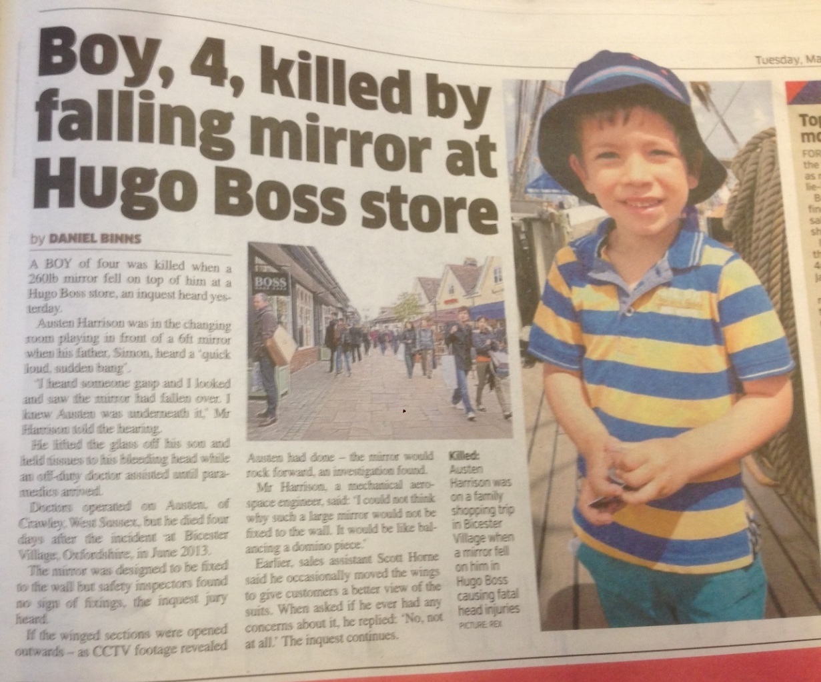

Brought to you by
ROOT CAUSE: Glue not installed in accordance with manufacturer’s requirements
(No ITP)
IMPACT
Financial cost to supplier: Significant
Reputations: Damaged
Environmental: Carbon footprint
Management Time: Significant
Programme: Post completion
Health & Safety: Lucky?
“Apply 6mm diameter bead of sealant direct to back of glass in vertical strips, spaced at 30-40mm centres. Immediately place glass in position and secure with good, even pressure with a slight twist action. Provide temporary support (tape) until adhesive has dried (24 -48 hours).”
Prevents bad things from happening
Quality risk management tool
Notes:
So, what might make the scales the other way? Well, let’s consider an example of what might happen where there is not an ITP.
Now, the picture here shows a piece of ply substrate on a wall with remnants of some glue. The finish along both sides of the very long corridor here consisted of panels formed from a ply substrate with a large piece of decorative glass glued to it. This was in an area of works handed over to the client and in use by the general public. In the early hours of one morning, a security guard heard an almighty crash and upon investigating found one of the glass panes lying smashed on the floor as the glass pane had come unstuck from the ply. As a result of this, every one of the panels had to be removed and temporary panels installed with mechanical fixings. The original panels then had to be driven back to the factory where they were originally manufactured to be reworked before being returned and reinstalled—this time with mechanical fixings. To give that a little more perspective, the site was in the South of England and the factory in Scotland. Furthermore, the works on site had to be done at night when the public were not using the area. Upon investigating this incident, it was highlighted that the requirements for the glue were clearly laid out in the manufacturer’s guidelines as stated here. However, an Inspection & Test Plan had not been produced and worse still up to the point of the incident no one had properly reviewed the manufacturers’ requirements.
So, what was the impact of that incident. Well, firstly, it cost the supplier a lot of money. Secondly, there was reputational loss to every party involved. Our client lost their reputation with the customers using the area, we damaged our reputation for delivering quality (because we were responsible to our client for the works) and thirdly the supplier’s reputation was also in tatters. There was an impact to the environment—carbon emissions for transport from the site location to the factory and back again. There was a great deal of management time that spent resolving the issue and dealing with the investigation. In this case, the was not a delay to programme as the work were handed over—had it occurred before completion, though, the delays could have been significant. Fortunately, the incident occurred when no one was about so no one was hurt. However, what really made me stop and think hard was not any of that. Let’s have a show of hands. How many people here have or have had a young child or have a close relative that is young? A few days after this incident, I read this very sad article about a little four year old boy that was killed when a mirror fell on him in a store. Reading that was a real heart in the mouth moment for me. How lucky were we that a similar outcome did not occur because we had not looked at what the requirements were and how we were going to meet it. Compiling an inspection and test plan would have been an ideal opportunity to examine the manufacturer’s requirements and ensure a suitable regime was established to make sure the requirements had been met.
So, simply put, one of the key benefits of an ITP is that we have an opportunity to prevent bad things from happening—i.e. mitigate the hazards. Of course, the difficulty is that you may never appreciate that that benefit has been realised. This is one of the key challenges that I find with quality. That often the benefit is about what does not happen as well as what does. I think we grasp this in safety. The effort we have put in to developing the culture of safety we have in the industry is primarily around an outcome in which we want to prevent bad things from happening. The Inspection & Test Plan is a tool which helps us do that for quality—just like the risk assessment is the key tool we use for safety. Therefore, one key benefit of the ITP is a risk management tool for quality!

Slide 6
Brought to you by
Supplier
Assurance:
  Make ‘sure’ the works are right
  Confidence the works are right
Intervention Points:
  Everything OK up to that point
Quality control part of assurance
Supplier
Principal Contractor
Principal Contractor
Client
Client
Identify requirements
Meet the requirements
Demonstrate the requirements
It has been built right
Make sure the client is happy
“The works have been built right”
ITP
Designer
Designer
Etc.
Statutory Authority
Statutory Authority
Notes:
But there are other benefits to an ITP. To think about how else the ITP can benefit us we need to consider who is involved in the delivery process and what they might want from an ITP. And what you want really depends on who you are. For example, when I’ve posed that question clients on what they want, it is fairly straightforward: I want to know it has been built right. What does the ITP allow the supplier to do? Well, it offers the opportunity identify the requirements and then firstly plan how they will be met and secondly how compliance will be demonstrated. And thirdly a middle party—for example, the principal contractor, Well, I suggest that party has two considerations. Firstly, how can I be sure that my supplier has built it right and secondly how can I make sure that my client is happy? The designer may also be involved—especially if there is a role to verify the works are right. Another example includes statutory authorities who also need to be involved checking the works—for example, the Building Control Officer.
In a nutshell then, the ITP can do two things: Firstly, it can help provide confidence the works will be built right and secondly confidence the works have been built right. The key word here is ‘confidence’. And this is how I explain quality assurance…making ‘sure’ the works will be right and providing confidence that the outcome meets the requirements.
But then again, we often talk about the ITP has a quality control document not quality assurance. We may think of quality control as checking that the output is as expected. Sometimes we speak about ‘intervention’ points—i.e. points in the delivery that we can identify to do a check to make sure that we are satisfied we have the output we want, i.e. it allows us to check that everything up to that point is OK. And that can serve two purposes: Firstly, it can allow us to detect where there a problem (an ‘error’). But, if I have given adequate thought to how I am going to achieve the right output, I shouldn’t be finding error. Is our Utopia therefore that we don’t need to inspect? In construction, we rely heavily on inspection. Why? I would suggest it is because we don’t have confidence it is right. Where should we be? Well, again, speaking with a client, the feedback I receive is that client would just like to be able to ‘dip’ in…reassure themselves it is still right. So, secondly actually, intervervention point in this case are not used to find error—but as a mechanism to assure, i.e. provide ‘confidence’. And this is where our control can also become a key part of our assurance.

Slide 7
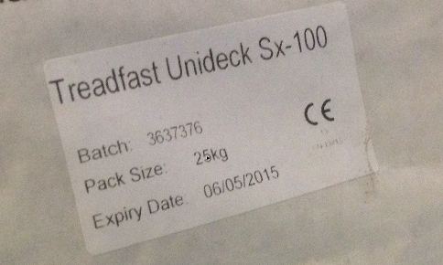
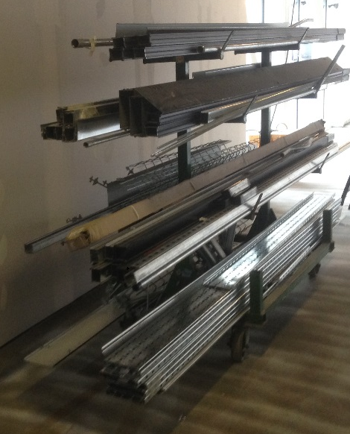
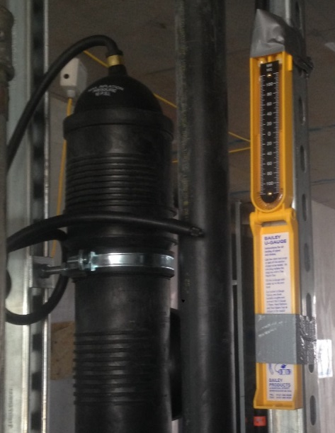
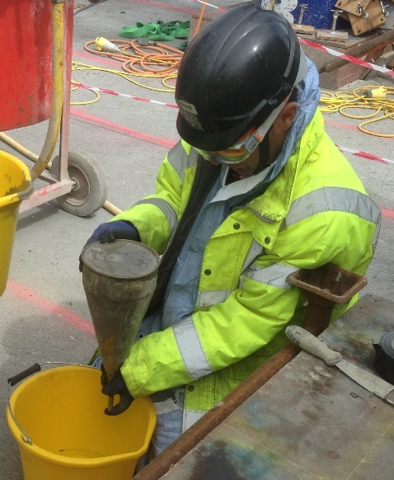
Brought to you by
Must be able to prove it is right
  Especially self-certification
  ‘What if?’ factor
Weight of evidence
Proactive approach:
  Confidence processes are in place to achieve the right outcome
  E.g. audit / surveillance
Notes:
And there is another point that comes out of this. To deliver ‘quality’, just getting it right is not enough. We have to be able to prove it is right. How many of us are delivering under self-certification contracts? At any point in the process, we should be able to freeze frame where we are and demonstrate that up to that exact point, the works are fully compliant. My challenge to managers is, if you were asked to demonstrate in six months time that the works are compliant, could you? I was speaking with someone recently and we called it the ‘what if factor’. What if something is identified as not right down the line—can you prove you did it right. An example which sticks in my mind is firestopping. It was highlighted by the client that the fire stopping between rooms above the ceiling was inadequate. It’s was a long time down the line after completion. Could it proved it was right when it was installed? It couldn’t. Even though, it was quite probable that others had damaged it, there were no records to prove it was right. And that resulted in a significant cost to the original installers to rectify an issue which may not have been down to them. Sometimes, we refer to this as ‘weight of evidence’—is there a sufficient weight of evidence to demonstrate compliance. I’m not speaking about having reams and reams of paper—but sufficient. Photos are fantastic. When I was managing delivery of site works, I used to get myself in the habit of looking out for compliance evidence…for example, a photo of the expiry date of the materials on site which would demonstrate they were in date when we installed them, photos to demonstrate the materials were stored correctly, and to demonstrate tests took place correctly.
So, the evidence you plan to retain should be noted on your Inspection & Test Plan However, I would us this opportunity to add that just because it is not noted on your ITP, it does not mean it is not a valid piece of proof which can be included in your records. And because I did it as I went along as part of my day job it didn’t actually take me any noticeable additional time. But I built up a continual ‘picture’ if you like that my works were compliant which at a later date could be used to provide ‘confidence’ to anyone who asked.
We may also choose to take a more proactive approach. I am going to a wedding in a couple of days. One of my friends is also going and we have booked to stay at the same hotel. Now, we are meeting at the hotel and then heading on to the venue from there. Now my friend wants to know way in advance all the details…what time, how far is it, how are we going to get there etc. To be honest, I can’t help but find that a little annoying. But then I think about what my friend wants—confidence that the outcome (i.e getting to the wedding venue on time) will be achieved through knowing that the process is in place to achieve that. And it is the same for us in construction. Our clients ask for evidence that there is a plan in place and it is adequate. We might find that rather frustrating at times but it is only to provide confidence the outcome will be right. That might be why, for example, we include audit and surveillance within our inspection and test regime—they can help provide confidence it is going to be right by allowing us to review the process and satisfy ourselves it is adequate for the task.

Slide 8
Brought to you by
Reduce risk
Proof it is right
Resource
Benefits
Confidence it is right
Programme
Effort
Sacrifices
Notes:
So, having covered that, let’s go back to this principle of ‘perceived value’. If I understand the benefits that the ITP could provide, can I tip the scales away from the con’s towards the pro’s. Let’s consider the benefits I have discussed. Firstly, the ITP can prevent bad things from happening—it is my quality risk management tool. Secondly, it enables us to plan how we will provide ‘confidence’ to ourselves and others the works will be and are right. And finally, it can be used to specify evidence to demonstrate works are right both now and should we need it later.
Yes, there may be resource, time and effort required before the start of the activity to produce the ITP. We may even need to delay the programme but perhaps now we can now appreciate how the benefits outweigh sacrifices which must be made in the short term.

Slide 9
Brought to you by
ITP as a process
Confidence
INPUTS
ITP
OUTPUTS
Evidence
(TRANSFORMATION)
Right First Time
Notes:
But I said that I wanted to look at ‘how’ the ITP can add value from two perspectives. Yes, there is the ‘how’ in terms of, say, the benefits which we have discussed. However, there is also the how can we get value from the perspective of the methodology. So far, we have just thought about the ITP as a document. Like any document, it can’t just stand alone. There are inputs to this document and we want to achieve an output—for example, works which are right first time, confidence for our client, and the evidence for now and later.
The ITP may be thought of as a mechanism by which we are transforming inputs into a tangible output…i.e. In other words, it is part of a process not just a document. This process involves producing the ITP, implementing the ITP and ensuring that the ITP requirements are completed. So, what we need to consider are the step by step actions we must take to enable that process to generate the outcome we want—i.e. the ITP procedure.

Slide 10
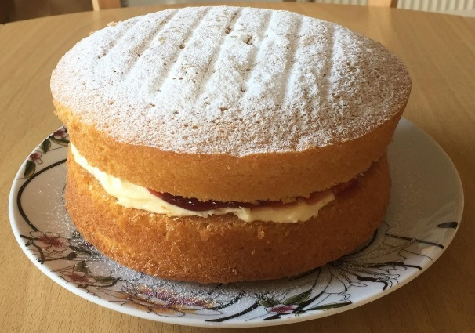
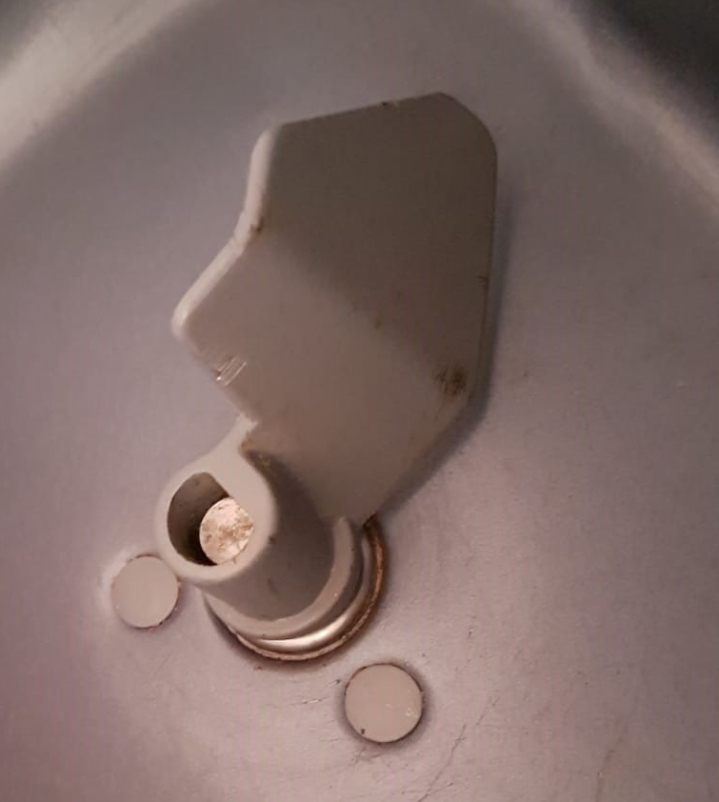
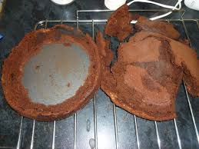
Brought to you by
Inputs to the ITP
Customer requirements
Information
Materials
Method
Environment
Equipment
Timeline
Expertise
Monitoring
Lessons Learnt
Notes:
Now I speak about the inputs to the activity to achieve the right outputs. Ultimately, I suggest this is very similar to thinking about a Project Quality Plan. We are just looking at it from the perspective of the activity—not the project as a whole. The analogy I often use if that of a cake. Now one place you will not find me is on British bake off but I have been known to be in the kitchen once or twice. Therefore, if I do bake a cake the first thing I have to do is to get some information—i.e. the recipe book. That tells me what the ingredients (i.e. my materials) must be. It also gives me a step by step guide to producing the cake—i.e. my method. It tells me the environment which is required for my cake to be successful—what temperature I need the oven to be. And it tells me the timeline for what I’m doing—in what order I have to mix the ingredients and how long the cake should be in the oven. I do have to have a certain amount of expertise to cook the cake—for example, I need to know what it means when it says ‘fold the flour’. The recipe will also tell me what equipment I need…grease proof paper, the cake tin etc. And finally I might need to monitor—for example, use a timer to check how long the cake is in the over. Now, if any one of those elements is not right, my cake will likely be flop.
When it comes to bread, though, I cheat a little and I use my breadmaker. It is great. I put the ingredients in, set the timer, and wake up to a nicely baked loaf. One time, though, I did that but I forgot to put the mixer on the spindle. My equipment was not right. I ended up with a gooey mess. I learnt a lesson and now I always check that I do have that in place.
This analogy highlights what I am thinking about when I create my ITP. Firstly, I need to think about the requirements in the information and I put them in the plan. However, there may be other aspects that are not in the information but I know I need to include it so I can get it right. For example, may be the specification does not say I must have competent people undertaking the works. However, I know it is a key factor so I am going to include it. Just like my breakmaker incident, perhaps I’ve learnt a lesson through bitter experience and I’m going to include this because I know it will reduce the risk of getting it wrong. Don’t’ be afraid to expand beyond the written documents—the ITP is your document. How do I make sure it provides most value? I want to prevent bad things from happening, enable ‘confidence’ is will be and is right, and ensure I have the evidence to demonstrate it down the line.

Slide 11
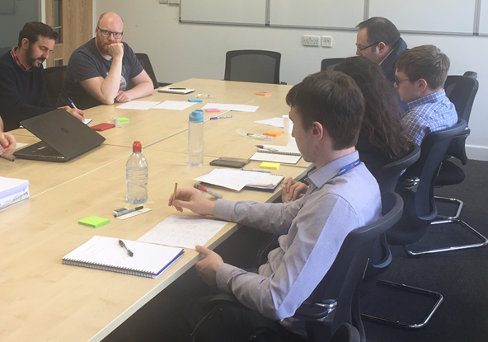
Brought to you by
Inputs to the ITP
Workshop
  Experts
  Brainstorm
‘Reverse Fishbone’
What would I do if I wanted to make sure this went wrong?
Equipment
Environment
Monitoring
Materials
People
Materials
Notes:
How might you determine what those items are? Well, aside from going through the relevant documents and picking out the requirements, there are probably many ways but one of the key ones you might consider is holding a workshop. Get the experts around a table in a room and brainstorm it. What needs to be in our ITP? One very useful exercise I recall was where we had representatives around the table from each of the suppliers involved in internal fit out of an apartment. We collectively discussed the checks required so that each trade thought about the requirements of the others—a fantastic way to manage interfaces.
Sometime, I find what I call a ‘reverse fishbone’ diagram can help. Very often we use a ‘fishbone’ diagram to analyse why something went wrong. I just change the question. How do I get this right? I can then determine my categories: e.g. materials, people, equipment, environment etc. and use those as prompts to consider what is included. Another technique, is to consider this. If I wanted to make sure this went wrong, what would I do? That will give you ideas on what you need to do to get it right.

Slide 12
Brought to you by
Risk Assessment
Method Statement
ITP
Checklist
Safe System of Work
Quality Management System (Activity)
COSHH
Lifting Plan
Manual Handling Assessment
Supplier QMP
Standard Operating Procedure
Notes:
Another important aspect is that this must not just be about the ITP isolation. Very often when speaking about quality I use safety analogies because people understand it and can relate to itand there are many parallels between safety and quality. So, let’s think about what we may have in place for safety prior to undertaking an activity. When planning an activity on site, we won’t only have a risk assessment. There are likely a suite of other related documents. For example, we have the method statement, we may need a manual handling assessment, COSHH Sheets, perhaps a lifting plan etc. All these combine to create a safe system of work. And it is the same when we are looking at an activity on site for quality. Just like the risk assessment, the ITP is our main document, but we are likely to have other items. The most common additional document of course is the checklist. We will come back to that a little later. There may, though, be others items. We might want a Standard Operating Procedure for example or a quality management plan from our supplier.

Slide 13
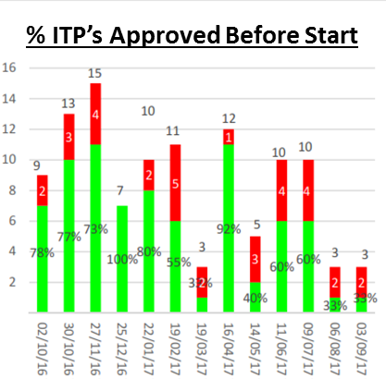
Brought to you by
Step 1: The ITP Tracker
Tracker
  Lists ITP’s
  Production timeline
  Ownership
  Monitoring / Reporting
Notes:
So, how do we incorporate all of this into a procedure which can result in the ITP providing maximum value? Let’s consider five steps. The first step for me is always creating an ITP tracker because this is the way I monitor the process. The tracker does four main things for me. Firstly, it lists all of the ITP’s in advance as far as possible . Secondly, I can incorporate the ITP production timeline so I can take a proactive approach—i.e. I consider the parties and the mechanisms that are going to be used to produce the ITP. For example, when does it need to be provided by the Subcontractor, do we need to allocate a date for workshop, when do I need to issue it to my client for acceptance etc. It allows me to allocate an owner to each ITP—the individual with overall responsibility for the ITP from production to close out —and update that when there is a change of personnel. One of the most significant challenges I have had is ensuring clear ownership for an ITP all the way to close out—what happens when one person leaves and another joins? And finally, the tracker also allows me to report progress very easily—I can show my senior management how we are performing, for example: how many ITP’s were produced before works started, how many ITP’s were right first time, how many are we outstanding? The tracker is a ‘live’ document which sits on the system and is updated on a continual basis.

Slide 14
Brought to you by
Step 2: Produce the ITP
a) Introductory Information
Notes:
The next step is producing the ITP. Now, as I have already mentioned, the ITP document itself will likely vary from one organisation to another. We can, though, consider some of the elements that you might include in an ITP.
So, most ITP’s will have some form of introductory information. This will likely include the title, a reference number, and revision control. It is also useful to clearly state the scope of the ITP—and it can help to include not only what is included within the ITP but also highlight pertinent aspects which is not included in the ITP—for example, this ITP relates to the concrete slab but not the substrate. We have spoken about the inputs which we may think about. Before starting to produce an ITP, gather all the relevant information...design drawings and specification, the manufacturer’s requirements for the materials which will be used, are there specific contract requirements, are there requirements within your business management system which need to be incorporated and how about updates to the design within RFI’s or TQ’s in addition to lessons learned. Remember as well that one document might be referenced in another—for example, the design specification might reference a British Standard. Some ITP’s incorporate signatures on the front to verify who has produced, reviewed, and agreed the ITP for use. And finally, we often use abbreviations and coding to make the ITP more concise and therefor it is useful to include these as a reference.

Slide 15
Brought to you by
Step 2: Produce the ITP
b) Delivery Stages
Notes:
The ITP should not be just related to the stage where the works are physically constructed. It needs to cover the every aspect of the activity. It can help to break this down into stages and think about the delivery process chronologically. So, for example, what do we need to do prior to construction? Then, how will we ensure the materials are compliant? Next, and one element which can be forgotten is off site manufacture. By the time materials get to site, it is too late. So, how are we going to ensure and demonstrate compliance of the works carried out away from site? Off site manufacture can present a significant risk—at least on site we can generally observe what is happening. And then we need to construct the works on site, there may be testing and commissioning involved and finally the close out stages. Very often this includes ensuring we close out any nonconformities—i.e. snags, defects and nonconformity reports and ensuring final certification is in place. So, make sure you understand which stages apply to the activity in question.

Slide 16
Brought to you by
Step 2: Produce the ITP
c) Main body
Input to achieve the right outputs
Documented requirements + other
Uniquely identify each line item
Clear ownership
Be specific (e.g. exact clause)
“Apply 6mm diameter bead of sealant direct to back of glass in vertical strips, spaced at 30-40mm centres. Immediately place glass in position and secure with good, even pressure with a slight twist action. Provide temporary support (tape) until adhesive has dried (24 -48 hours).”
Notes:
So, then we need to complete the main body of the ITP. Let’s briefly look at what might be included. Firstly, it helps to give each line on the ITP a unique reference making it easier to identify each item. Next I’m going to think about the line items that I need to include in the ITP in each stage—going back to the analogy of my cake, I’ll extract these from the documented information but perhaps include other items fi I think they add value to the process. Taking the example of the glue used to stick the glass panels to the ply that I discussed earlier I can identify two compliance activities--application of the glue and application of the support tape. Moving across my ITP, I then specify where the requirements came from and what it is. I would advise you to be as specific as possible here so it is easy to reference back to the original requirement–for example, you many need to include the document revision number and clause of the specification. Next, how will I ensure compliance? Well, I decided I’m going to use a checklist to help and also monitor the time of the application and removal of the tape to ensure it is not removed too early. Then I specify how I plan to demonstrate the works are compliant—inspection during the works by relevant parties but also photos for future reference and the project manager will do surveillances. I also clarify the evidence (i.e. documented proof) will be made available and where it will be held—the signed checklist, surveillance forms and photos archived in a compliance evidence folder. But the ITP can be flexible and include other information if I so wish. For example, for example, may also choose to specify who has responsibility for closing out the actions. This gives ownership related to specific aspects of the ITP itself. And, perhaps I might also specify the resources required.

Slide 17
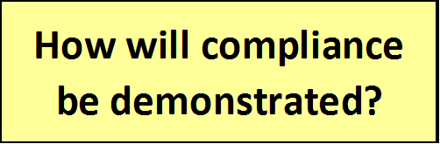
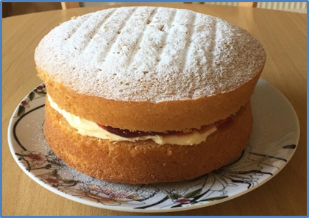
Brought to you by
Step 2: Produce the ITP
Inspect or Witness?
  Witness test of works / check being undertake
  Inspect to confirm OK
Is it a Hold Point?
  Must not proceed until verified OK & authorisation received
Audit
Surveillance
Submit for Information
When / How much?
  Confidence / risk
d) Main body
Notes:
And finally I’m going to specify the intervention points: which parties are involved, how and when are we going to ‘intervene’ in the process to check and reassure ourselves everything is OK. Here I decide whether the party is inspecting (i.e. is actively involved) or just bearing witness to the compliance activity taking place. I also decide if these interventions are hold points—a gateway if you like beyond which works must not progress until the activity has been confirmed to be completed satisfactorily and appropriate authorisation given. And then as mentioned previously I might include an audit activity (which the client, for example) might witness, surveillances or I might just submit to the party in question for information. Another very important aspect here, though, is how much is inspected or witnessed overall by that party—100%, 50% or less? I suggest this is down to judgement based on risk and the level of confidence required.
So, going back to my example of the cake what intervention points might I have?…well,I might check I am using self-raising not plain flour and that the flour is in date (like I said—making cakes is not something I do that often so who knows how long its been in the cupboard). I might have a hold point where I check the oven temperature is right before I put the cake in. I might inspect the cake to make sure it looks cooked and test it is cooked by dipping a knife in the middle. And, finally, I’ll do some destructive testing to make sure it is OK—I will eat the cake.

Slide 18
Brought to you by
Checklist
“Provide temporary support (tape) until adhesive has dried (24 - 48 hours).”
Sign off facility for each party
Include sufficient details
Ensure hold points are clearly indicated
Include facility to add information
Notes:
Now earlier, I mentioned the checklist and it is worth highlighting some important aspects which you might consider as this is the key tool we will likely use on site. Now it is not uncommon for the checklist and ITP to be confused but they are actually different documents. The ITP is our plan whereas the checklist is the document we use on site as an aide memoire of the requirements and to verify the checks detailed in the ITP have been carried out. When reviewing checklists I find some common issues. For example, it is important to ensure that a facility is provided for all relevant parties to evidence a satisfactory check. Make sure appropriate detail is included: the checklist is supposed to be an aide memoire for what is being inspected. ‘Visual inspection’ is often far too vague. If specifying fixings, what fixings at what centres, for example? Hold point must be clearly indicated and related back to the ITP. And finally, checklist can be a useful mechanism to record information related to the installation: for example, when the tape was applied and when it was removed.

Slide 19
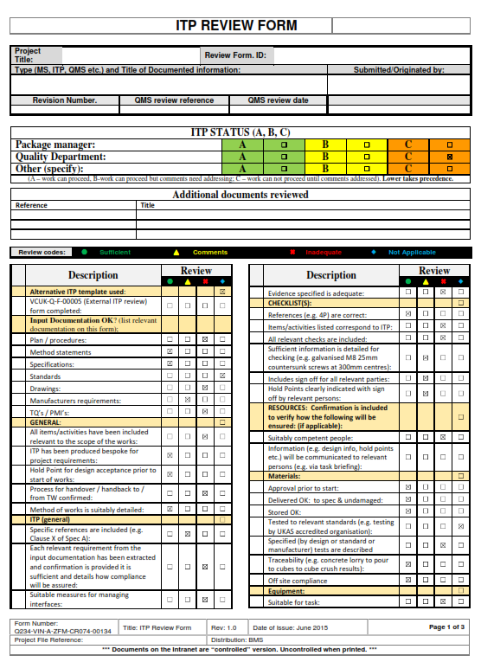
Brought to you by
Step 3: Review / Approval / Acceptance
Principal Contractor
Client
Supplier
Collaboration
Checklist for ITP:
  Aide memoire
    Producing
    Checking
  Comments:
    Formal record
    Track closure
Notes:
It is quite probably that the ITP (and relevant information such as the checklist) will be reviewed by various parties firstly to check it is OK and secondly to ensure add information. This can be quite an arduous and lengthy process..often going backwards and forwards between parties. One way that I suggest this process might be made easier is to meet face to face with relevant persons to discuss and agree the contents. Where this happens, we have found that the approval or acceptance of ITP’s when submitted formally is much more likely to be right first time. Furthermore, when people do check ITP’s, I sometimes wonder exactly what is being checked. We can also end up with scribbled comments all over those documents and tracking closure of those comments can be a nightmare. You might like to consider a review form providing an aide memoire of the items which should be included within the ITP. This can also provide a more structured approach to record, track and close out comments.

Slide 20
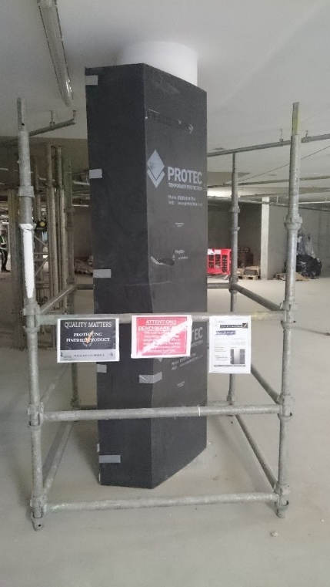
Brought to you by
Step 4: Communicate the ITP
Briefings
  Important / relevant items of the ITP
  What is different to normal?
  What checks are required?
Mock ups / Benchmarks
Notes:
Step 4 (and the step immediately prior to starting works) should be communicating the contents of the ITP to those involved in the activity. We talk about briefing the ITP. I would suggest that is not really what we want to do. What we want to do is effectively communicate the important aspects to those who need to know them. Many of those we speak to do the activities day in and day out. So, what is special about this activity? What are the specific requirements for this particular project? What specific checks are required? Where are the hold points? Benchmarks and mockups are a great way to communicate the standard. As part of the briefing show those doing the work the benchmark—i.e. the minimum standard which is considered acceptable. Mock ups can be a very useful for showing details…For example, examples of drylining details can be produced to indicate exactly how the works should be installed.

Slide 21
Brought to you by
Step 5: Adhere, Comply, & Close Out the ITP
Notes:
And then the final step: Are we doing what the ITP says? Within Taylor Woodrow we call it ‘Adhere and Comply’. This is nothing more complicated than people’s behaviour being aligned to the ITP. You may choose to formalise the sign off at the end with relevant parties verifying that all the items have been completed satisfactorily including provision of the specified evidence.

Slide 22
Brought to you by
Programme: Allow enough time
Effort:
  Train people
  Don’t over complicate
  ITP activity templates
  Digital field technology
Resource: Include requirements in contracts
Resource
Resource
Programme
Effort
Effort
Proof it is right
Sacrifices
Confidence it is right
Reduce risk
Benefits
Notes:
So, I suppose one final aspect to consider might be whether there is anything we can do to swing perceptions even further towards the ITP providing positive value--might we be able to reduce some of the sacrifices (or if you like potential blockers)? For example, if we allow enough time in the programme to produce the ITP, we can remove the element where we might be delaying the programme because of the ITP. If we make sure that people are trained and competent, we may reduce the effort required. And, yes, an ITP will always require effort to produce and may need to be quite detailed but it does not need to be over complicated. For example, one organisation I know has two templates—one used for simple tasks and another used when the task is more involved. You may also decide to put more detail within the checklist rather than list everything within the ITP. Although each ITP should be unique to the specific requirements, it can help to produce and utilise ITP activity templates—for example, have a generic concreting template which can be developed further to make is bespoke to a particular project. Use of digital field technology can make stage 5: application and close out of the ITP much more efficient. And finally, perhaps we can help the resource issue by detailing the exact requirements within contracts so appropriate allowance can be made in tenders and the planning process. All this will mean the cons we associate with the ITP are significantly reduced.

Slide 23
Brought to you by
Value of the ITP: Weigh up of Pro’s & Con’s
Step 1: ITP Tracker
Step 2: Produce
Step 3: Review & Agree
Step 4: Effectively communicate
Step 5: Adhere, Comply & Close Out
Notes:
So I’ve spoken about the value generated by ITP’s being a weigh up of if you like the pro’s and con’s and that each of us particularly dependent upon our role may have a different perspective on what the sacrifices are and the benefits we will receive from an ITP. But whatever our perspective the reduction in risk, the confidence it is right and the evidence of compliance resulting from the ITP process can certainly outweigh the sacrifices. I’ve also spoke about how ITP’s can generate value form another stance and that is through an adequate process methodology perhaps in five stages: The Tracker, Producing the ITP, Reviewing & Agreeing the ITP, Communicating the ITP and finally closing it out by ensuring all the requirements have been achieved.

Slide 24
Brought to you by
Quality is an outcome
  Good: e.g. customer satisfaction
  Bad: e.g. error
Quality is about:
  What we deliver
  How we deliver it
ITP is the key tool to:
  Manage quality risk
  Get it right first time
  Deliver ‘confidence’
  Ensure appropriate evidence
Notes:
So, I’d like to leave you with this thought. I could speak to you for a long time about how we might think of the concept of ‘quality’. However, ultimately ‘quality’ is an ‘outcome’. That outcome can be good (for example, customer satisfaction) or it can be bad (for example, error is a consequence of poor quality). It is the choices which we make which determine that outcome. Quality is concerned with what we deliver but also, because it is a key influencer, how we deliver as well. The ITP is our key tool in construction for managing quality ensuring what we deliver and how we deliver creates and outcome which is right the first time, that can be confident it is right, and we can demonstrate it. It does that by providing us with a structured mechanism to identify the requirements and inputs, define how the requirements will be achieved and how they will be evidenced.
But just like any tool, to achieve the outcome we want, it must be used and used effectively. My challenge to you is are you ensuring that tool is used within your organisation to generate maximum positive value. There are many senior people in the room here today. For example, are you making sure everyone is able to produce an adequate ITP and then making sure that they are using it effectively? Because ultimately, the consequences of not doing that could cost you, your organisation, and even others dearly

Slide 25
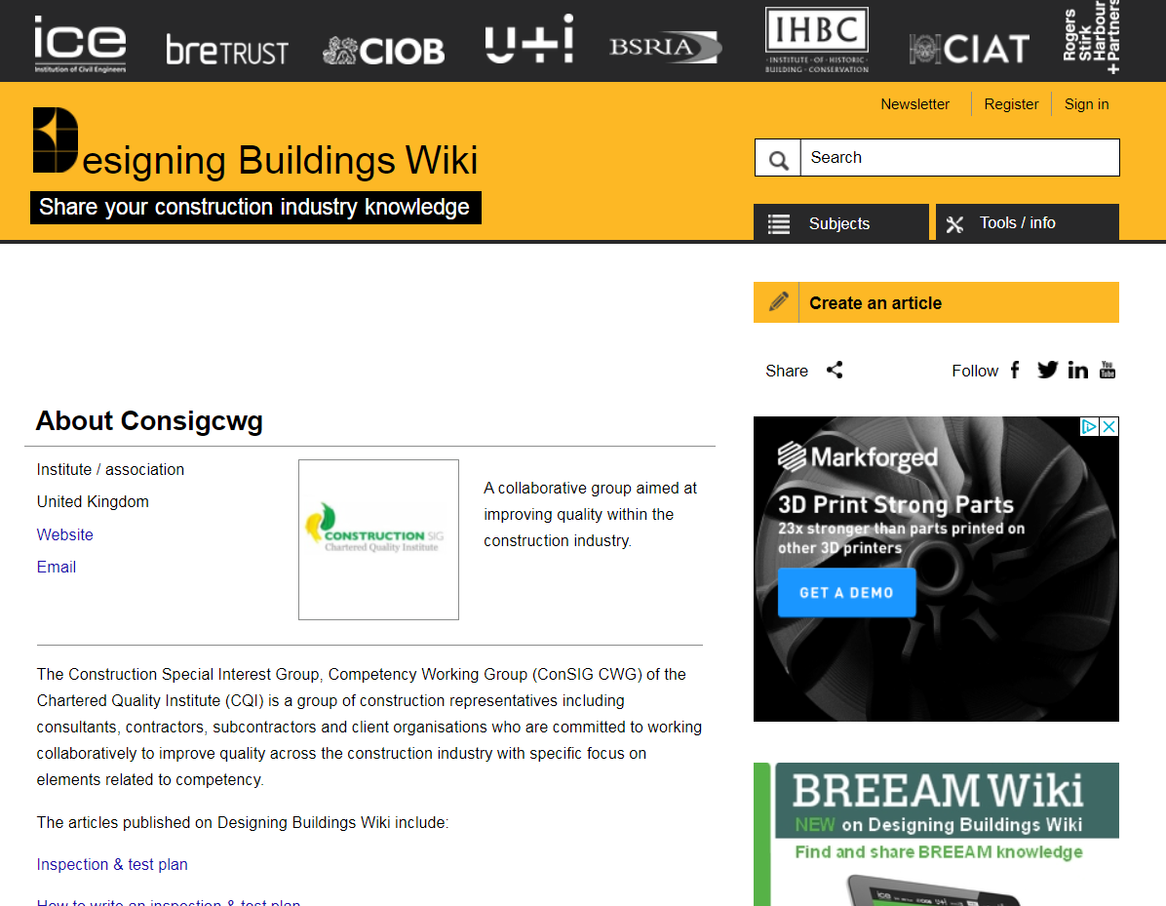
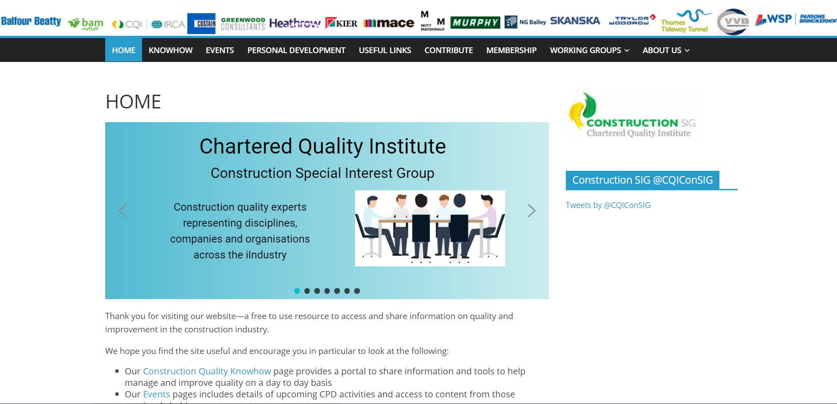
For more information:
Brought to you by
Email: cqiconsig@gmail.com
Website: www.consig.org
https://www.designingbuildings.co.uk/wiki/User:Consigcwg

